Slide 1
Design Patterns and How to Use Them
By Tanmay damle

Slide 2
Agenda
What is a Design Pattern ?
Types of Patterns
Singleton
Factory
Decorator
State
Resources

Slide 3
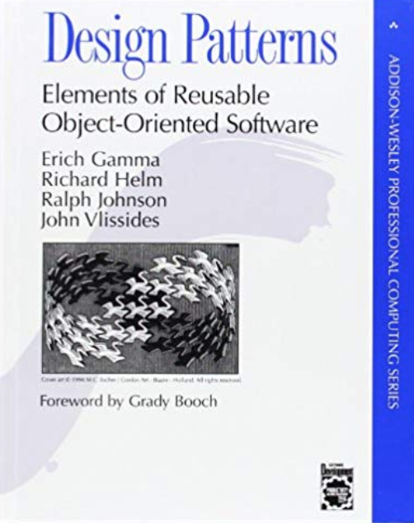
Design Patterns

Slide 4
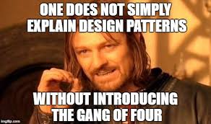

Slide 5

Gang of Four

Slide 6
What is a Design Pattern ?
Design patterns are typical solutions to commonly occurring problems in software design. They are like pre-made blueprints that you can customize to solve a recurring design problem in your code.

Slide 7


Slide 8
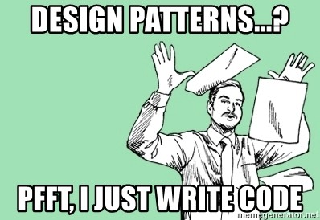


Slide 9
Why should we learn Design Patterns?
Design patterns are a toolkit of tried and tested solutions to common problems in software design.
Design patterns define a common language that you and your teammates can use to communicate more efficiently.
Make your code efficient.
Test systems before even they are Implemented.

Slide 10


Slide 11
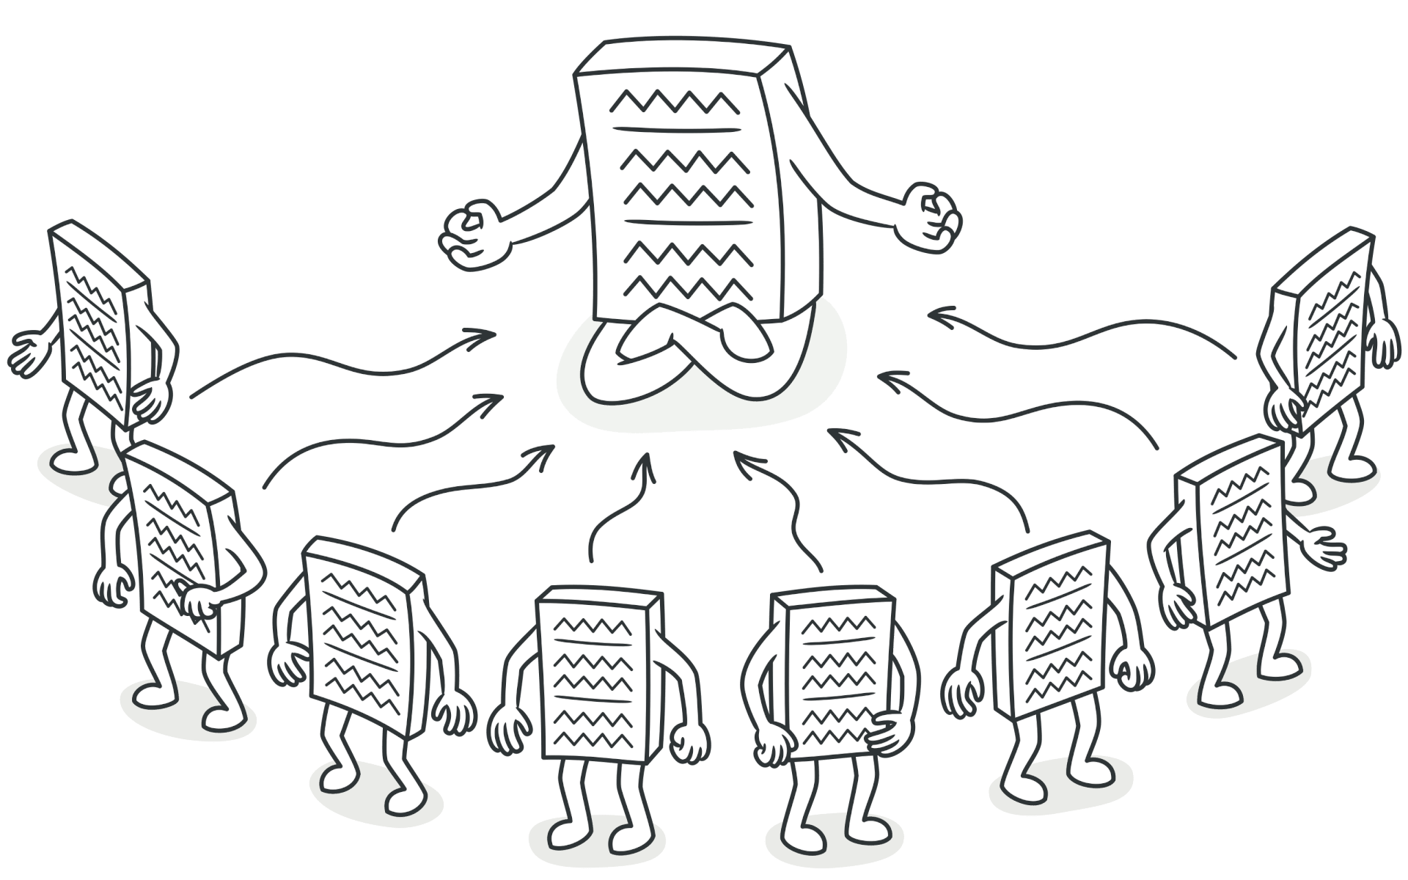
Singleton

Slide 12


Slide 13


Slide 14


Slide 15


Factory

Slide 16
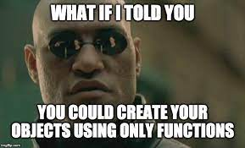
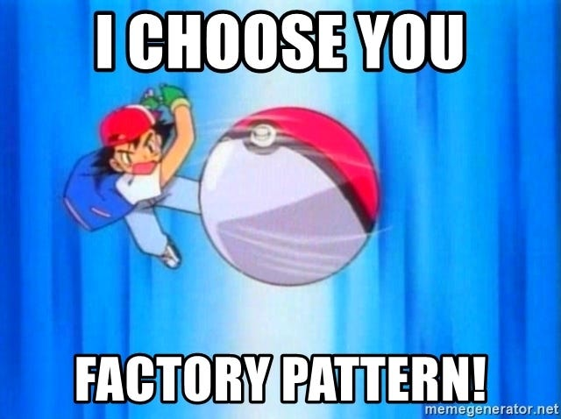

Slide 17
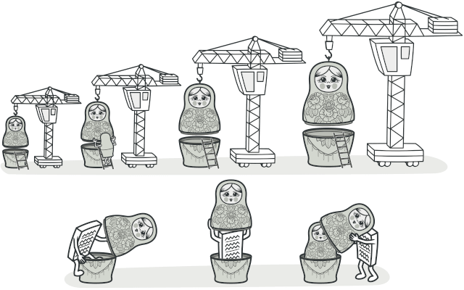
Decorator

Slide 18
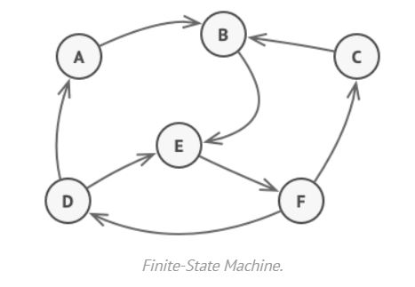
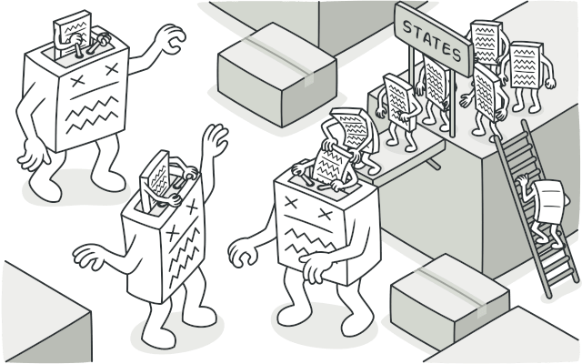
State

Slide 19


Slide 20
Types of Design Patterns
Creational - Creational design patterns provide various object creation mechanisms, which increase flexibility and reuse of existing code.
Structural - Structural design patterns explain how to assemble objects and classes into larger structures, while keeping these structures flexible and efficient.
Behavioral - Behavioral design patterns are concerned with algorithms and the assignment of responsibilities between objects.

Slide 21
Resources
https://refactoring.guru/design-patterns
https://github.com/donnemartin/system-design-primer
https://github.com/ashishps1/awesome-low-level-design
https://github.com/DovAmir/awesome-design-patterns
https://github.com/sindresorhus/awesome?tab=readme-ov-file
Make Projects, use Design Patterns !
Think about Ideas and make system design

Slide 22

Shameless Self Promotion Part I

Slide 23

Shameless Self Promotion Part II

Slide 24
Thank You
Contact me
damlet@uwindsor.ca
Or Say Hi to Tanmay Damle On Teams

